Slide 1
Team Members
DIGI GREEN ‘25
Problem Statement: E-waste is a rapidly growing environmental hazard Due to improper disposal and unethical recycling practices. The absence of standardized global regulations makes it difficult for businesses and consumers to verify ethical recyclers. A lack of transparency leads to illegal dumping, pollution, and unsafe handling of hazardous materials. There is a need for a centralized platform that ensures compliance with global recycling standards, enhances accountability, and simplifies e-waste management through certification and AI-driven monitoring.
Team Name: SMART SPARKS
Member 1 – 23CS214 – Shankaripriya S- CSE
Member 2 -23CS225 – Subathra R - CSE
Member 3 – 23CS216 – Sharan Prashanth S – CSE
Member 4 – 23CS227 – Sujan P – CSE

Slide 2
PROBLEM DESCRIPTION
E-waste is one of the fastest-growing waste streams globally, leading to severe environmental and health hazards.
Toxic Pollution: Improper disposal releases hazardous substances like lead, mercury, and cadmium, contaminating soil, air, and water.
Lack of Global Standards: Recycling regulations vary widely across countries, making compliance difficult for businesses operating internationally.
Unverified Recycling Claims: Many recyclers claim ethical disposal but lack verifiable certifications, leading to fraudulent practices and illegal dumping.
The absence of a unified certification system makes it challenging for businesses and consumers to identify trustworthy recyclers.
Our Goal: Create a centralized, AI-powered platform that ensures transparent, ethical, and standardized e-waste recycling globally.

Slide 3
IDEA / SOLUTION
Innovation & Uniqueness
Proposed Solution:
We propose a centralized, AI-driven platform that certifies, monitors, and manages e-waste recycling practices globally.
Businesses and recyclers register on the platform.
The platform verifies recyclers’ credentials against international standards.
AI algorithms monitor submitted recycling claims for fraud or unethical practices using real-time data & audits.
Certified recyclers receive digital badges visible to businesses & consumers.
A dashboard provides reports, compliance scores, and suggestions for improvement.
Incorporates AI monitoring to detect false claims, illegal dumping, and unethical practices.
NLP Chatbot for Guidance Personalized recycler recommendations. System adapts through continuous learning.
Transparent system where businesses & consumers can verify recycler credentials.
First platform unifying regional standards into one certification system.based on BIS 17862:2022 (Bureau of Indian Standards) and ISO(Internation Organization for Standardization) 14001:2015

Slide 4
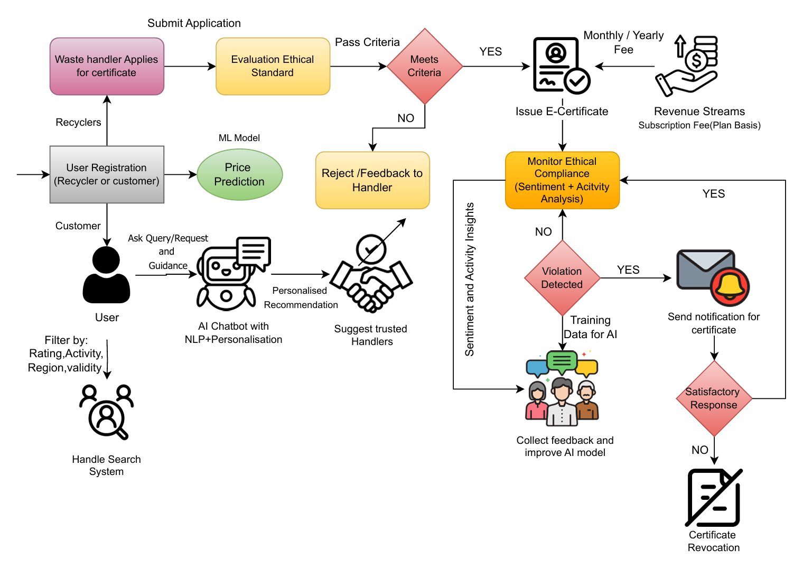
WorkFlow
Technologies Used
Category | Technology
Frontend | Next.js, Tailwind CSS
Backend | Flask
Database | MongoDB
AI/ML | TensorFlow, PyTorch
LLM Integration | LLMs
Deployment | Docker
Security/Auth | OAuth 2.0
GitHub repo:
Link

Slide 5
MARKET ANALYSIS
EXISTING SOLUTION
KEY GAPS
Platforms like EcoATM, and Earth911 focus on collection and recycling logistics.
Certifications (e.g., R2, e-Stewards) rely on periodic audits with no real-time oversight.
No system integrates AI for ethical validation or continuous compliance tracking.
No feedback or violation reporting system from the public or customers.
Partner with NGOs and schools
Regional language kits and offline packs
Future R&D in VR/haptics for tactile learning
No transparency for businesses or consumers.

Slide 6
FEASIBILITY AND VIABILITY
Feasibility Analysis
Potential Challenges & Risks
Pilot programs can be launched regionally before global rollout.
Scalable: Platform can expand globally with minimal incremental cost.
Technically feasible: technologies like AI, cloud, and blockchain are mature.
Data Privacy in feedback and monitoring.
User Trust in automated certification decisions.
Adoption Resistance from recyclers.
Partner with Governments & NGOs for global acceptance.
Use Secure Data Encryption & Blockchain for transparency.
Create Awareness Campaigns to drive adoption.

Slide 7
IMPACT AND BENEFITS
1
Businesses & Corporations can ensure ethical partnerships by verifying certified recyclers.
2
Governments & Regulators benefit from simplified enforcement and monitoring of e-waste disposal practices.
3
Consumers & Communities gain access to responsible e-waste disposal options, promoting sustainability.
4
Environmental Impact – The solution reduces pollution and minimizes toxic waste, protecting ecosystems.
5
Economic Growth – It boosts the ethical recycling industry and creates new job opportunities.
6
Transparency & Trust – AI-powered verification prevents fraud and promotes accountability in e-waste management.

